Slide 1







LAYERED vs MODULAR vs MICROSERVICE
Which one is best for you?
Download the Presentation
Halil İbrahim Kalkan
Co-Founder & Software Architect | Volosoft
hibrahimkalkan
hikalkan

Slide 2

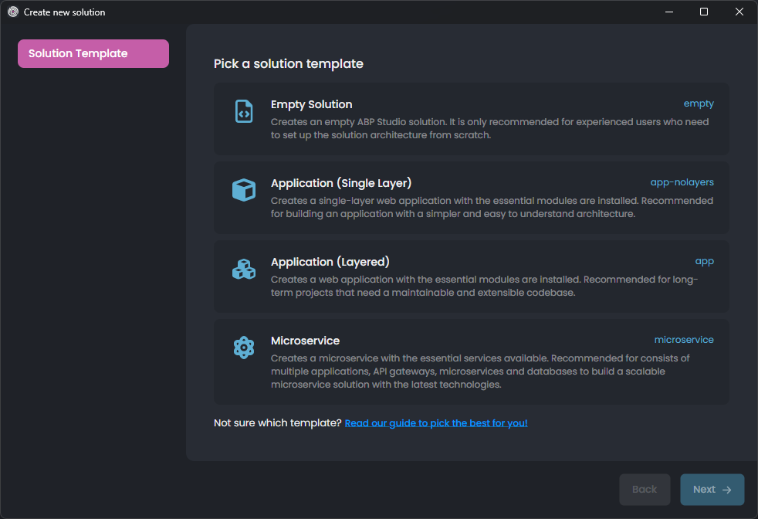
What is an ABP Startup Template?
Pre-architected solution structure
Well-structured code organization
Library integrations & configurations
Pre-integrated ABP modules & themes
Mobile application & public website options
Multiple Database & UI Options
Production Ready

Slide 3
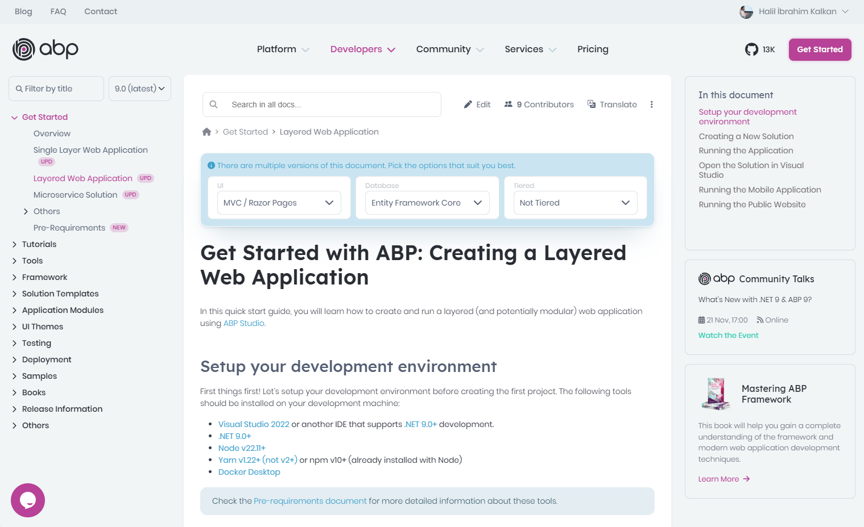
Documentation
Getting Started Create & run a solution
Tutorial Develop an application
Solution Structure All details of the solution
DEMO

Slide 4

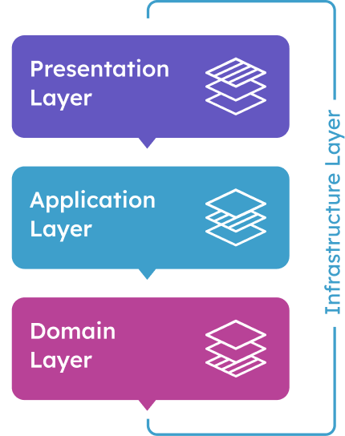
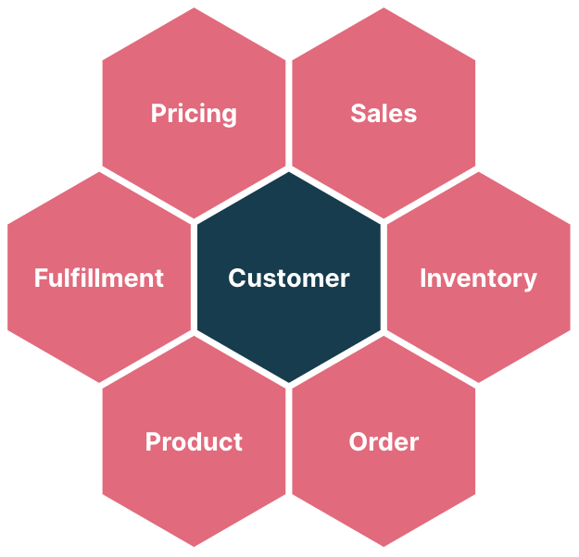
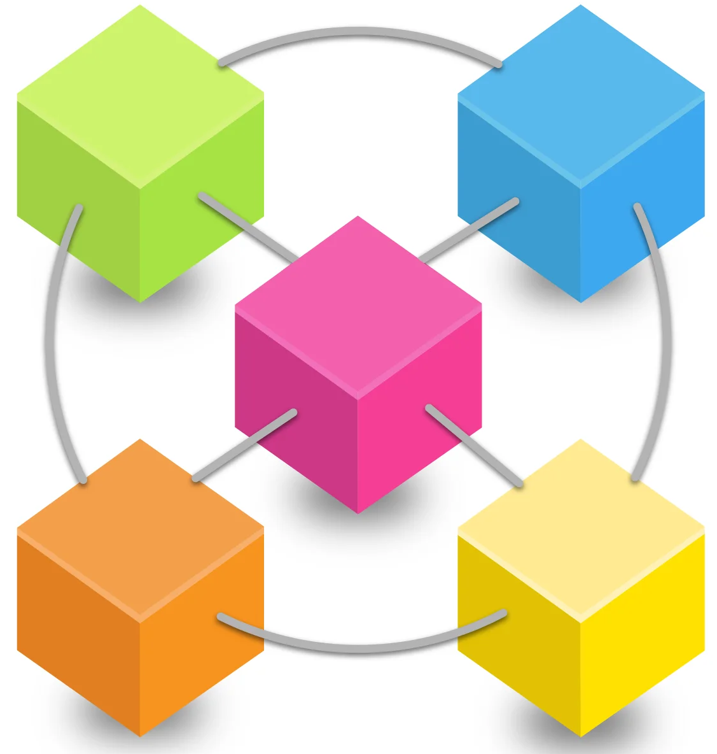
The Startup Templates
Single-Layer (non-layered) monolith application
N-Layered monolith application
Modular monolith application (based on Single-Layer or N-Layered applications)
Microservice solution

Slide 5
TITLE
Content
1
2
2.1
2.2
2.2.1
2.2.2

Slide 6
TITLE
Content
1
2
2.1
2.2
2.2.1
2.2.2

Slide 7
Which Architecture?
single-layer
n-layer architecture
modular monolith
microservices
Small project
Temporary project
A few developers
Middle-size project
Long-term project
A team of developers
Multiple applications
Complex domain
Multiple sub-domains
Multiple teams
Scalable codebase
Scalable performance (on multiple databases)
Complex domain
Multiple sub-domains
Multiple teams
Large company & budget
Devops culture
Scalable codebase
Scalable performance
Multiple technology stacks
Targeting too many users
- High availability
- Fault tolerance - Independent scale
%5-10
%50-60
%20-30
%5-10

Slide 8
TITLE
Content
1
2
2.1
2.2
2.2.1
2.2.2

Slide 9
TITLE
Content
1
2
2.1
2.2
2.2.1
2.2.2

Slide 10
THANKS FOR
LISTENING
Download the Presentation
Halil İbrahim Kalkan
Co-Founder & Software Architect | Volosoft
hibrahimkalkan
hikalkan

Slide 11
TITLE
Content
1
2
2.1
2.2
2.2.1
2.2.2

